Slide 1
Diabetic Ketoacidosis (DKA)
Life-threatening emergency
Gross insulin deficiency is the predominant problem of DKA
Most common in patients with
type 1 diabetes
Can occur in patients with type 2 diabetes due to progressive loss of β-cell reserve
A metabolic status caused by formation of “ketone bodies”
By-products are produced by metabolism of fatty acids for energy. This is usually due to inability to use glucose
Acetoacetic acid and Beta-hydroxybutyrate are commonly produced
They are acids which lead to drop in blood pH → potentially fatal
Ketones can also form during deamination of amino acids

Slide 2
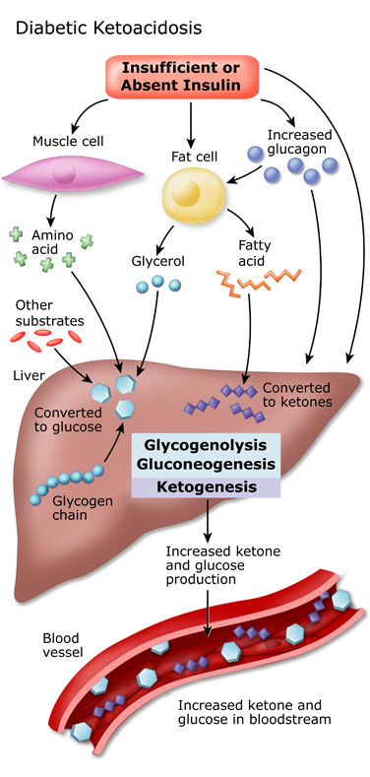

Slide 3
Hyperosmolar Hyperglycemic State (HHS)
An acute metabolic complication of diabetes mellitus characterized by impaired mental status and elevated plasma osmolality in a patient with hyperglycemia.
Occurs predominately in Type II Diabetics
  A few reports of cases in type I diabetics.
The presenting symptom for 30-40% of Type II diabetics.

Slide 4
Causes of DKA/HHS
Stressful precipitating event that results in increased catecholamines, cortisol, glucagon.
  Infection (pneumonia, UTI)
  Alcohol, drugs
  Stroke
  Myocardial Infarction
  Pancreatitis
  Trauma
  Medications (steroids, thiazide diuretics)
  Non-compliance with insulin

Slide 5


pathophysiology of ketoacidosis?
The patient can not utilize glucose from food due to insufficient insulin.
Energy is provided by fat breakdown (lipolysis)
Some of the free fatty acids released by lipolysis are converted into ketones by the liver causing a profound metabolic acidosis.
This patient compensates for this acidosis by hyperventilation (Kussmaul respiration)

Slide 6
Signs, Symptoms, and Treatment of Diabetic Ketoacidosis
Symptoms
Blurred vision
Increased thirst
Increased urination
Nausea/vomiting
Confusion
Loss of consciousness
Signs
Deep respirations
Fruity breath
Dehydration
Hyperglycemia
Ketosis
Acidosis

Slide 7
Diagnostic test findings
Serum glucose level 200 to 800 mg/dl
Low serum bicarbonate (0-15mEq/L) and low pH(6.8-7.3)
Serum ketone level: elevated 4+
Urine ketone level: elevated
Serum sodium level: decreased less than 135mg/dl.
Serum potassium level: elevated initially, then decreased because of Diuresis(3.5-5.0 mEq/dl).
Arterial blood gas (ABG) measurements: pH reflects acidosis
Hemoglobin (Hb) and hematocrit (HCT) levels: elevated because of diuresis and dehydration
Hemodynamic monitoring: pressures below the patient’s normal baseline reflect dehydration.
ECG: arrhythmias from potassium imbalance

Slide 8
Diagnostic Criteria for DKA and HHS
 | Mild DKA | Moderate DKA | Severe DKA | HHS
Plasma glucose (mg/dL) | > 250 | > 250 | > 250 | > 600
Arterial pH | 7.25-7.30 | 7.00-7.24 | < 7.00 | > 7.30
Sodium Bicarbonate (mEq/L) | 15 – 18 | 10 - <15 | < 10 | > 15
Urine Ketones | Positive | Positive | Positive | Small
Serum Ketones | Positive | Positive | Positive | Small
Serum Osmolality (mOsm/kg) | Variable | Variable | Variable | > 320
Anion Gap | > 10 | > 12 | > 12 | variable
Mental Status | Alert | Alert/Drowsy | Stupor/Coma | Stupor/Coma

Slide 9
Patient Management
Patient care management goal is to hydrate the patient and restore the acid base balance, and insulin therapy
Administer regular insulin first as a bolus, then as a continuous IV infusion to decrease serum glucose level.
Nil per mouth at least for 6 hours
Administer I.V fluids to correct dehydration (usually 0.9% or 0.45% saline solution) initially, given rapidly until serum glucose levels decrease to 200 to 300 mg/dl; then administer glucose solutions to prevent hypoglycemia caused by insulin administration
Administer fluids through a large-bore peripheral I.V line to allow for rapid infusion;
Administer I. V. potassium cautiously to replace serum potassium that returns to the intracellular fluid due to rehydration which leads to increased urinary excretion of potassium to prevent dysarrhythmias.
Assess and document continuous ECG rhythm; vital signs; mental status; heart, lung, and bowel sounds; urine output; and any signs and symptoms indicating changes in these parameters
Administer antibiotics to treat the underlying infection, if present
Heparin (5000U-sc) as prophylaxis for deep vein thrombosis (DVT)
Monitor and report any abnormalities in serum glucose and electrolyte levels
Obtain Arterial Blood Gases(ABG) measurements and monitor for hypoxemia and acid-base imbalance; monitor arterial oxygen saturation (SaO with a pulse oximeter
Provide safety measures to prevent accidental injury from altered level of conscious(LOC)
Nasogastric tube with LOC to prevent vomiting and aspiration
Position the patient for comfort; elevate the head of the bed to facilitate respiration and prevent aspiration
Teach the patient the causes of DKA
Teach the patient to recognize signs and symptoms or hyperglycemia requiring medical intervention
Instruct the patient in the proper technique for insulin administration and blood glucose testing to monitor diabetes, and have the patient demonstrate the technique

Slide 10
Complications
Hypoglycemia from overzealous insulin replacement.
Cerebral oedema may be precipitated by the rapid shifts in plasma osmolality during treatment and failure of serum Na⁺ to rise; leading to accumulation of water.
Symptoms: drowsiness, severe headache and confusion. (give mannitol 1-2g/kg).
Decrease phosphate level during treatment as it moves into intracellular fluids with potassium.(phosphate 9-18mEq/dl/24hrs).
Tissue hypoperfusion results from dehydration and may trigger coagulation and result in thromboembolism.

Slide 11
Nonketotic hyperosmolar syndrome (NKHS)
Nonketotic hyperosmolar syndrome (NKHS) is a metabolic complication of diabetes mellitus (DM) characterized by hyperglycemia, extreme dehydration, hyperosmolar plasma, and altered consciousness.
It most often occurs in type 2 DM, often in the setting of physiologic stress.
NKHS is diagnosed by severe hyperglycemia and plasma hyperosmolality and absence of significant ketosis.
Treatment is IV saline solution and insulin. Complications include coma, seizures, and death.

Slide 12
Diagnostic Criteria for DKA and HHS
 | Mild DKA | Moderate DKA | Severe DKA | HHS
Plasma glucose (mg/dL) | > 250 | > 250 | > 250 | > 600
Arterial pH | 7.25-7.30 | 7.00-7.24 | < 7.00 | > 7.30
Sodium Bicarbonate (mEq/L) | 15 – 18 | 10 - <15 | < 10 | > 15
Urine Ketones | Positive | Positive | Positive | Small
Serum Ketones | Positive | Positive | Positive | Small
Serum Osmolality (mOsm/kg) | Variable | Variable | Variable | > 320
Anion Gap | > 10 | > 12 | > 12 | variable
Mental Status | Alert | Alert/Drowsy | Stupor/Coma | Stupor/Coma

